Slide 1
Translation from Unstructured Meshes to Combinatorial Geometry for Nuclear Energy
Dimitri Kalinichenko
Mentor: Prof. April Novak

Slide 2
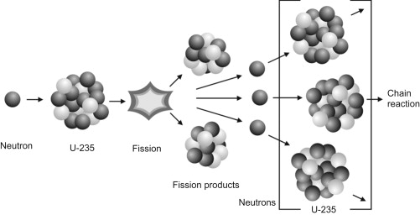

Project Motivation
Neutron behavior is important for nuclear reactor design
Drive nuclear reaction
Directly proportional to power
Determine the criticality and controllability
Governing equation is very complex
Integrals and derivatives
7 dimensions (time, space, energy, direction)
$$\frac{1}{v\left(E\right)}\frac{∂ψ}{∂t}+\hat{Ω}∙∇ψ+Σ_{t}ψ= \sum_{i=1}^{N}{λ_{i}C_{i}\frac{χ_{d,i}\left(E\right)}{4π}}+\int{dE^{′}}\int{d\hat{Ω}′}Σ_{s}\left(E^{′}→E,{\hat{Ω}}^{′}→\hat{Ω}\right)ψ\left(E^{′},{\hat{Ω}}^{′}\right)+\frac{χ_{p}\left(E\right)}{4π}\int{dE^{′}}ν_{p}\left(E^{′}\right)Σ_{f}\left(E^{′}\right)φ\left(E^{′}\right)+S$$
[1] M. Gill, F. Livens and A. Peakman, "Chapter 9 - Nuclear Fission," in Future Energy, 2014, pp. 181-198.
[2] J. J. Duderstadt and L. J. Hamilton, Nuclear Reactor Analysis, John Wiley & Sons, 1976.

Slide 3
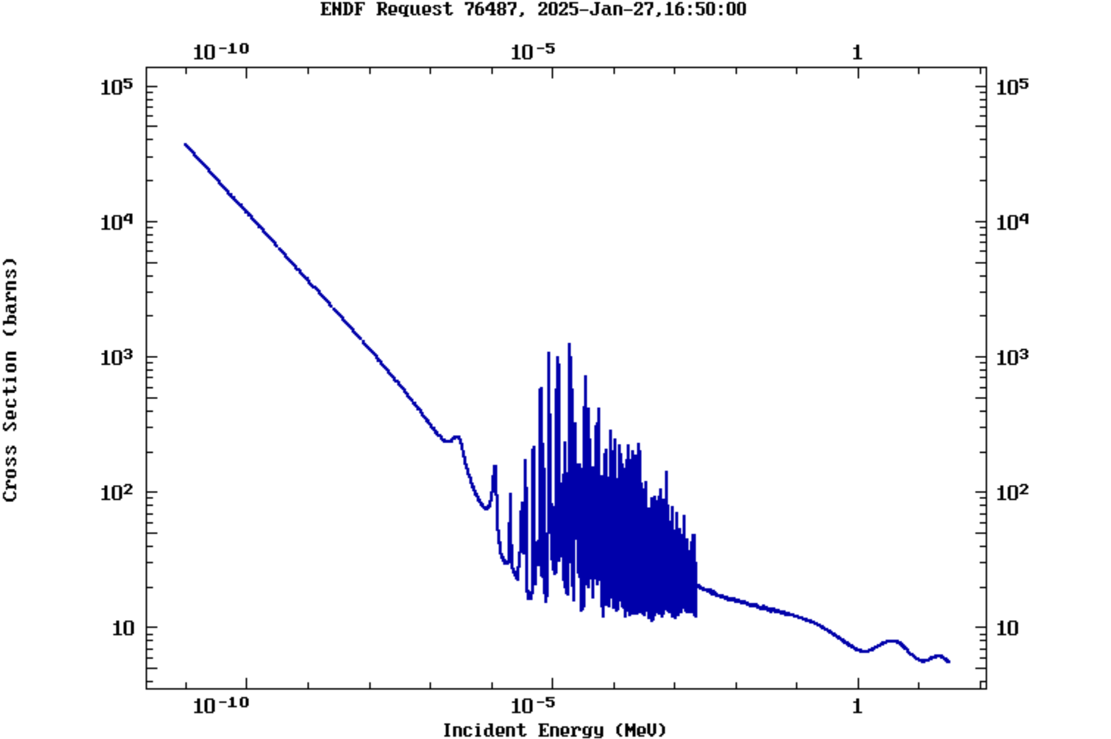
Project Background
Monte Carlo methods are state-of-the-art for numerical simulation
Statistical sampling of individual neutron behavior
Millions/billions of simulations needed
Invaluable for generation of interaction data
Deterministic solvers (finite element, finite volume…) are often used
Collapse continuous energy spectrum into discrete energy groups
Divide space into nodes and edges
Can be used for rapid iteration & time-dependent problems
[3] National Nuclear Data Center, "Evaluated Nuclear Data File (ENDF)," [Online]. Available: https://www.nndc.bnl.gov/endf/. [Accessed January 2025].

Slide 4
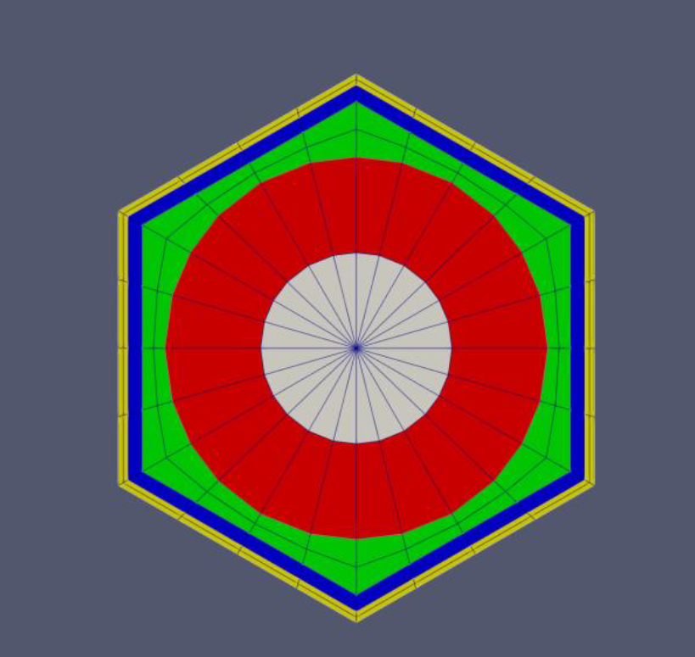



Project Goal
[4] Idaho National Labratory, "Multiphysics Object-Oriented Simulation Environment," [Online]. Available: https://mooseframework.inl.gov/releases/moose/v1.0.0/. [Accessed January 2025].
[5] Massachusetts Institute of Technology, UChicago Argonne LLC and OpenMC contributors, "The OpenMC Monte Carlo Code," [Online]. Available: https://docs.openmc.org/en/stable/index.html#. [Accessed January 2025].

Slide 5
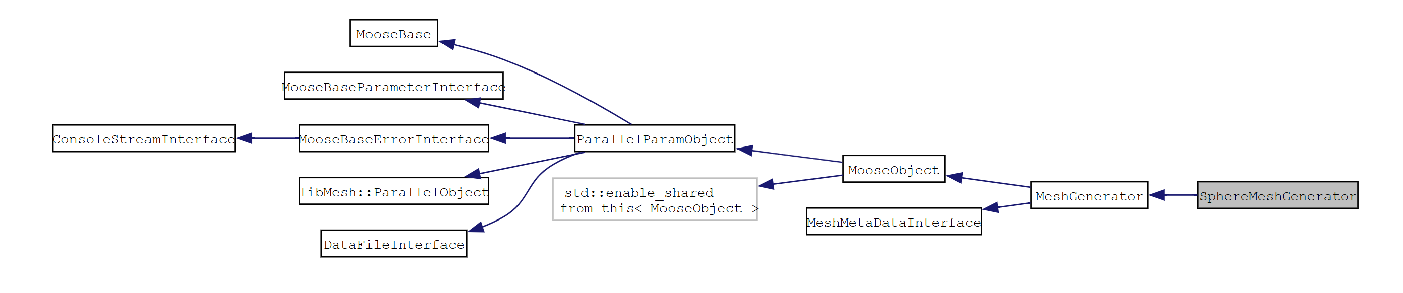
Methods – MOOSE mesh building
MOOSE is a finite element simulation framework
Can be used to make meshes that look like nuclear reactors
Meshing system is object-oriented
Uses mesh generator objects to operate on meshes in steps
Can leverage framework to identify geometry being created
[6] Idaho National Laboratory, "SphereMeshGenerator Class Reference," [Online]. Available: https://mooseframework.inl.gov/docs/doxygen/moose/classSphereMeshGenerator.html. [Accessed January 2025].

Slide 6
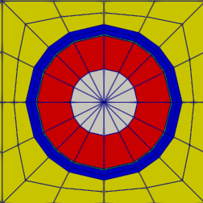
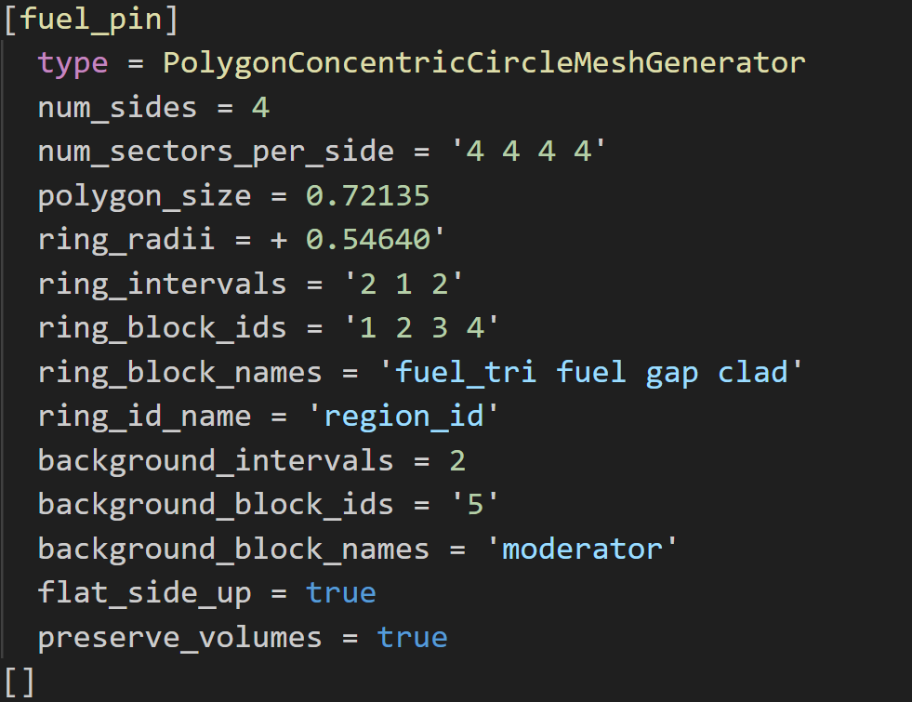
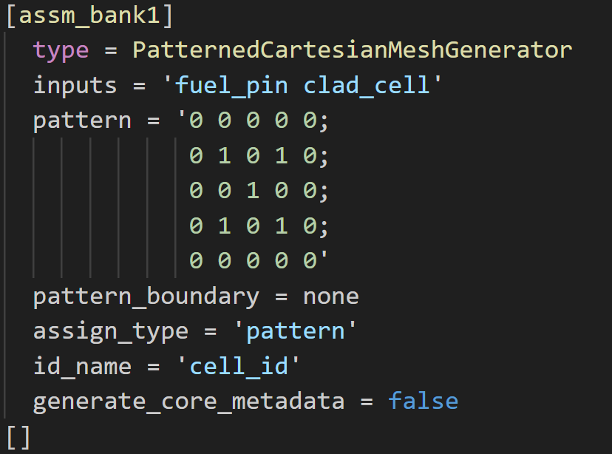
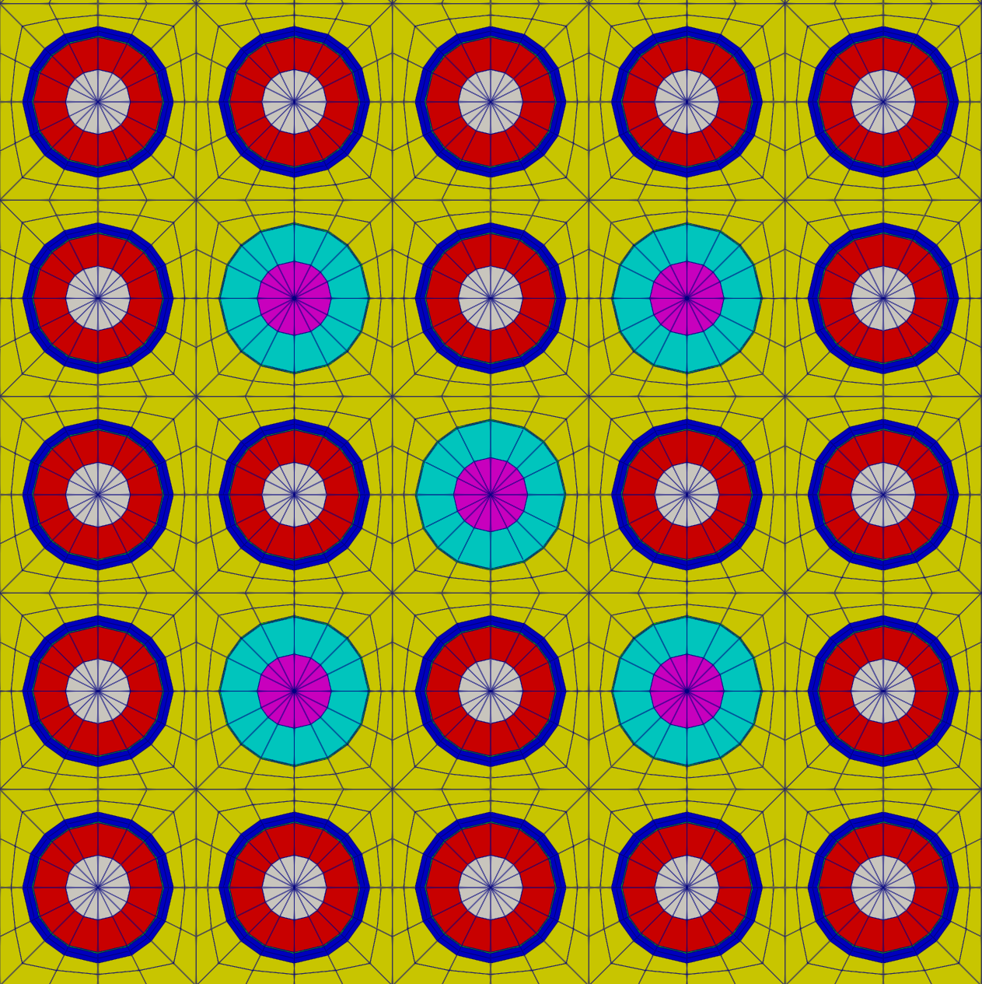
Methods – MOOSE mesh building

Slide 7
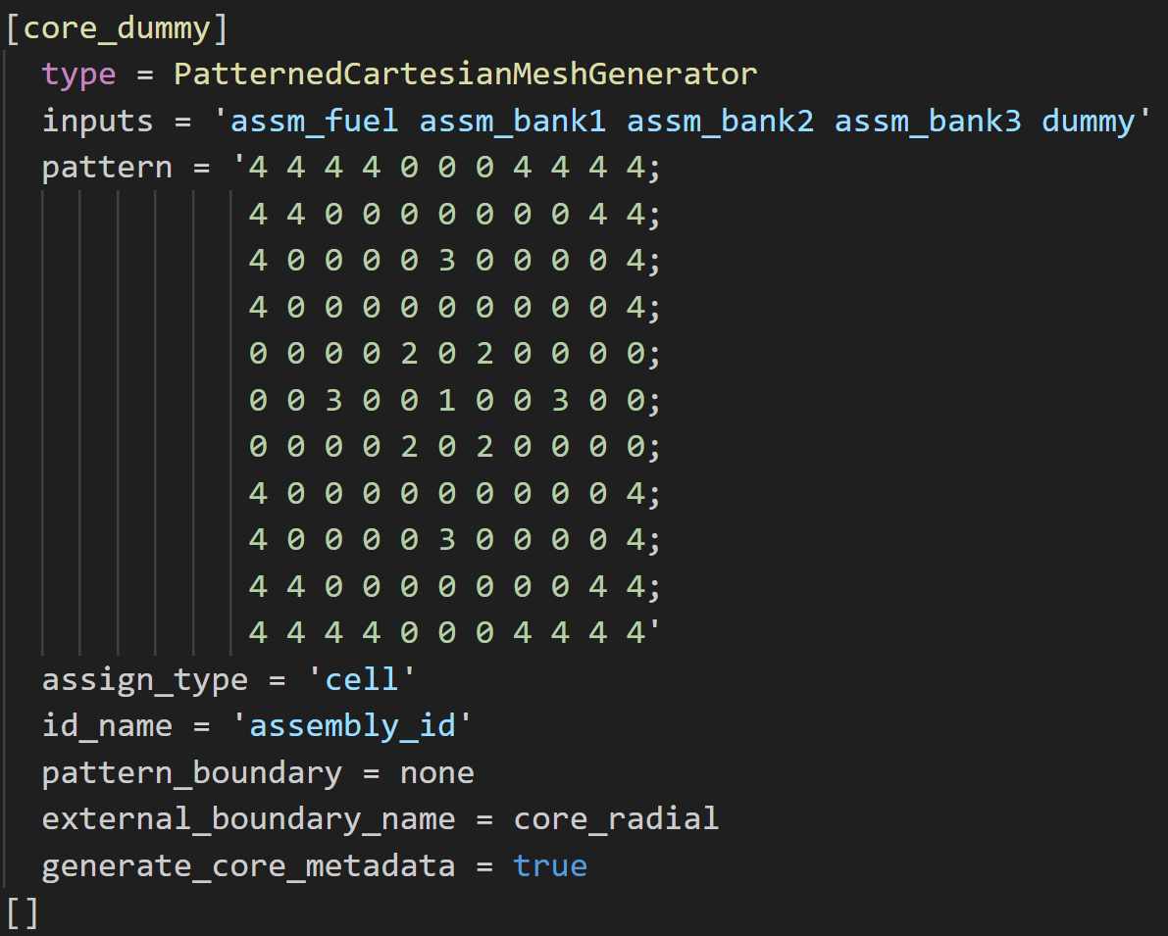
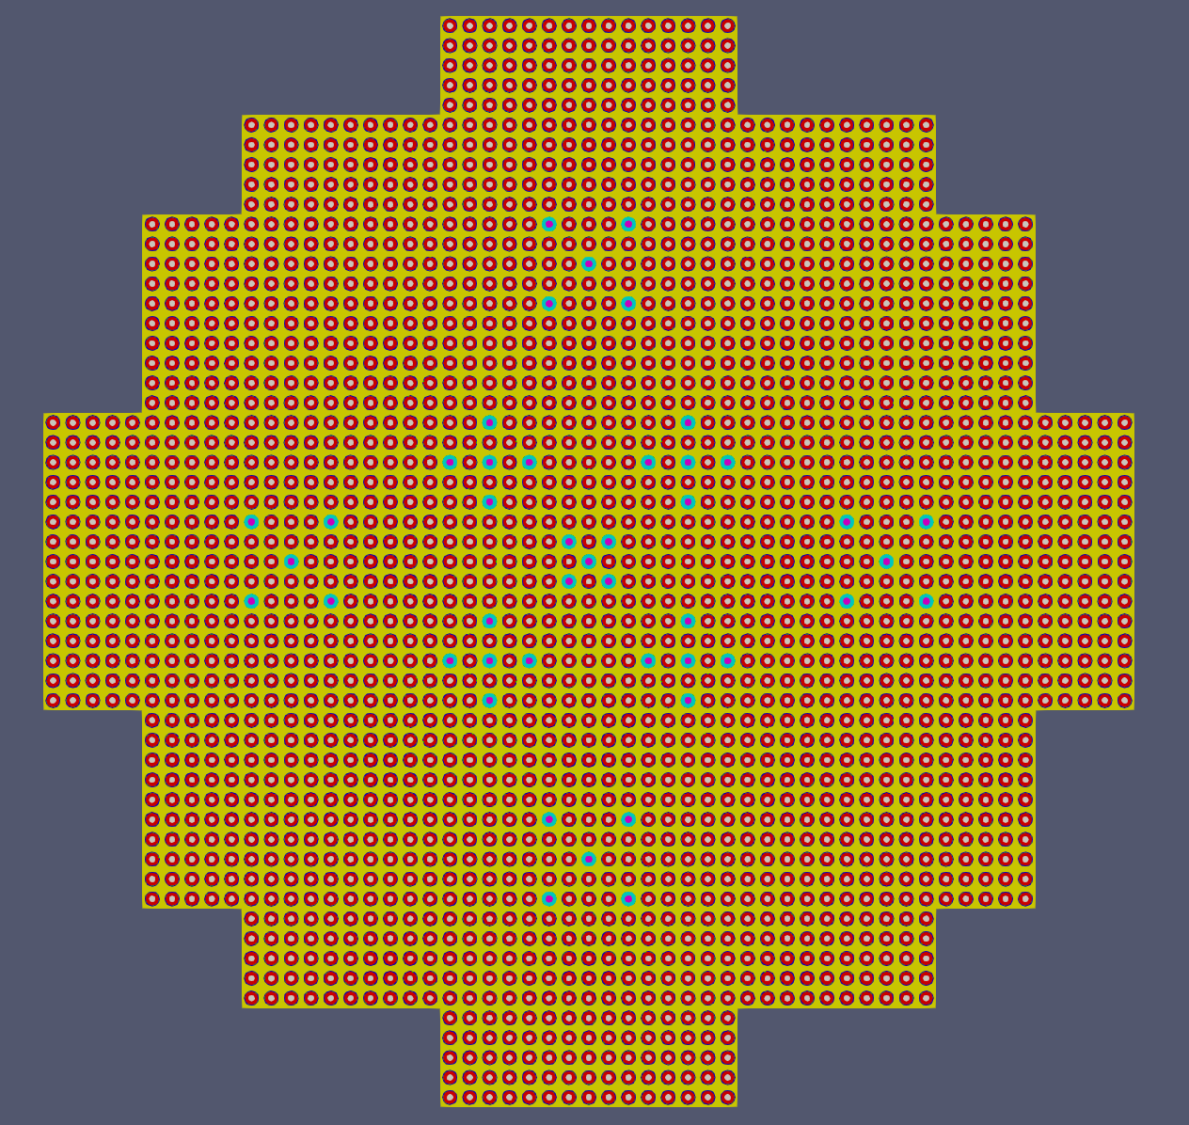
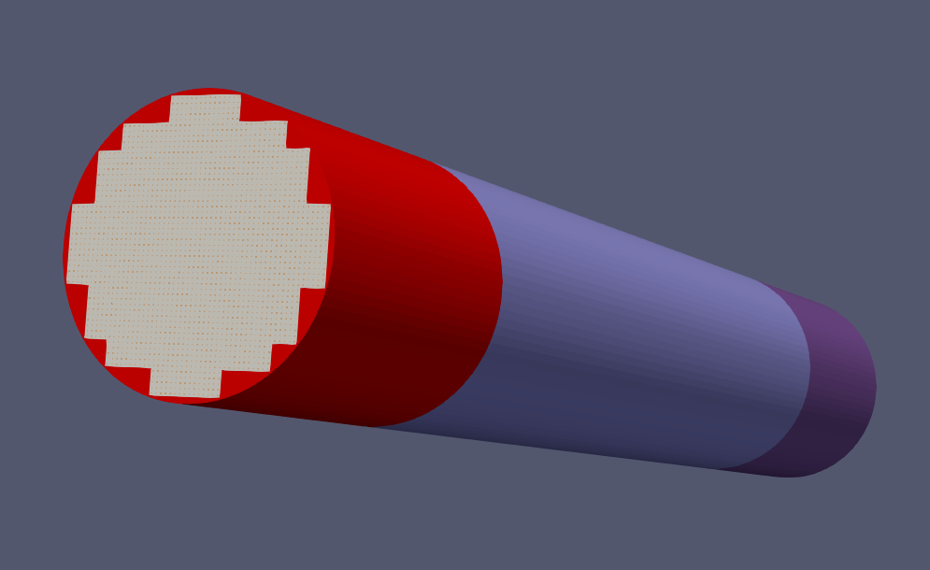
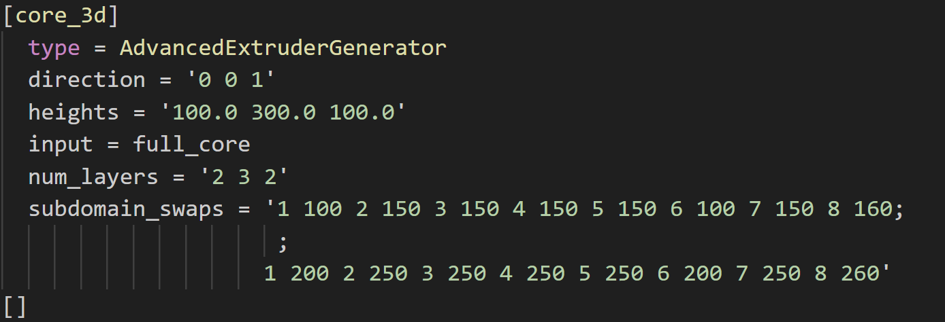
Methods – MOOSE mesh building

Slide 8
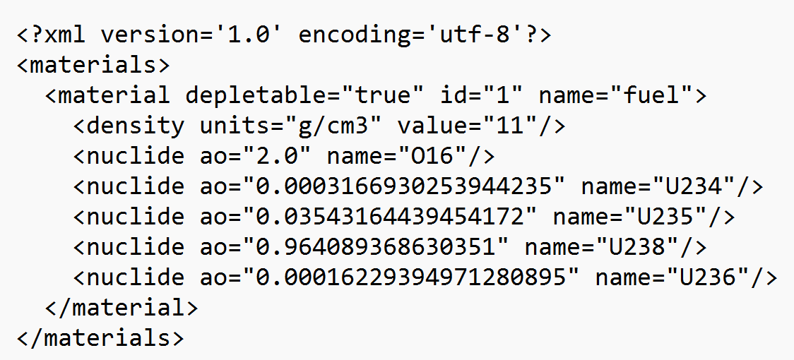
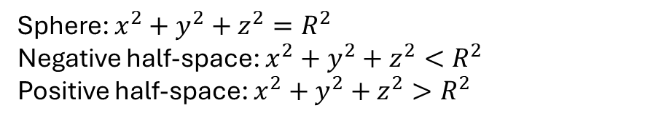
Methods – Translation to OpenMC
OpenMC is an open-source Monte Carlo code
Geometry represented by boolean combinations of surfaces
Surfaces in 3-D can be described by a characteristic equation
Half-spaces are regions that satisfy surface inequalities
OpenMC input is in the form of .xml files
Geometry
Material selection
Simulation settings
Sphere: $x^{2}+y^{2}+z^{2}=R^{2}$
Negative half-space: $x^{2}+y^{2}+z^{2}<R^{2}$
Positive half-space: $x^{2}+y^{2}+z^{2}>R^{2}$

Slide 9
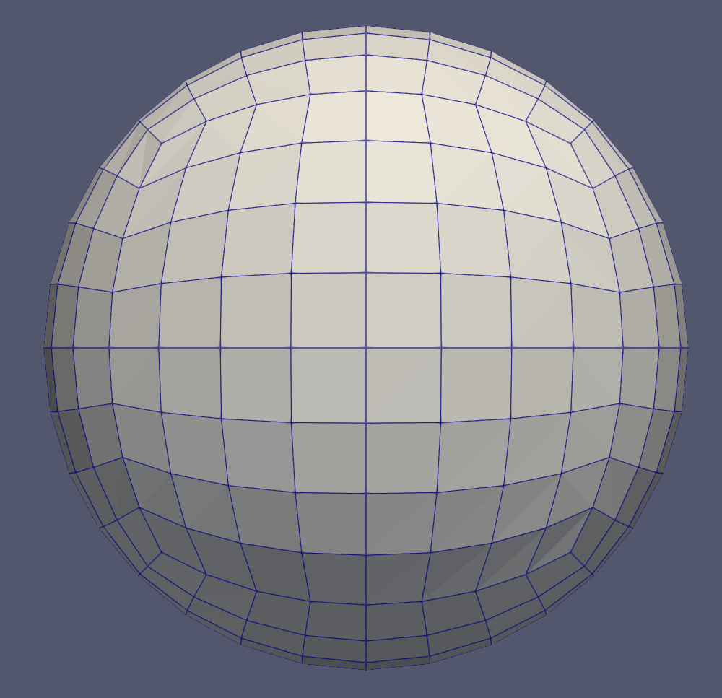
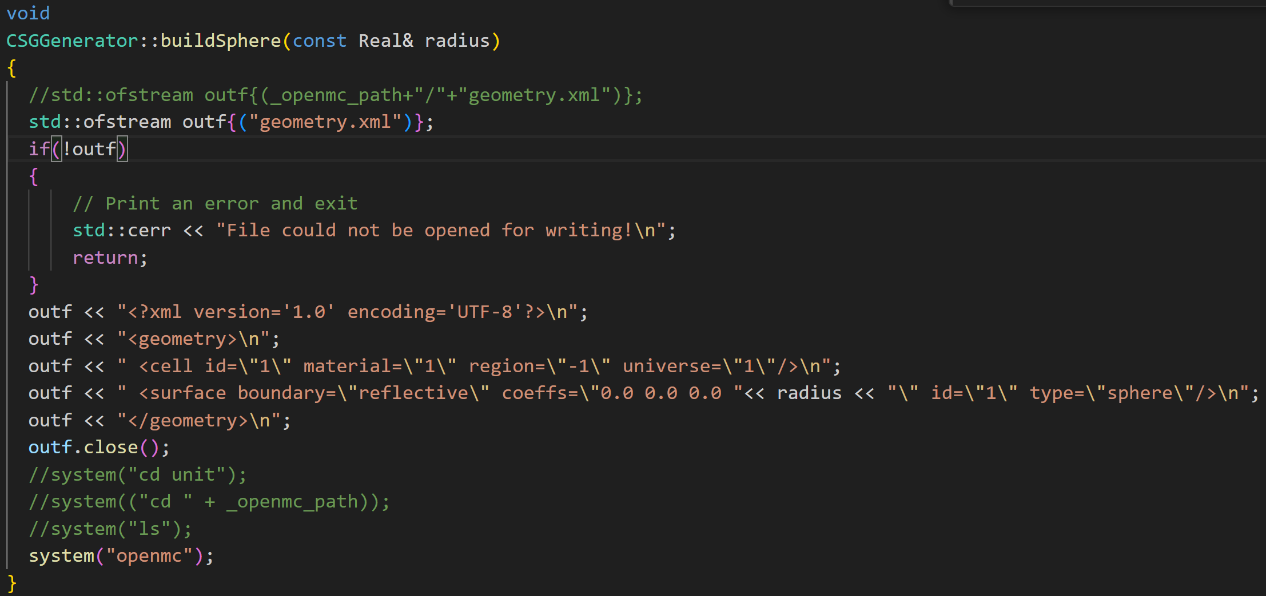
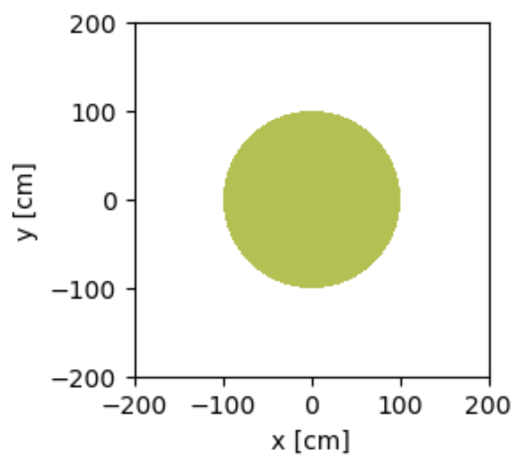
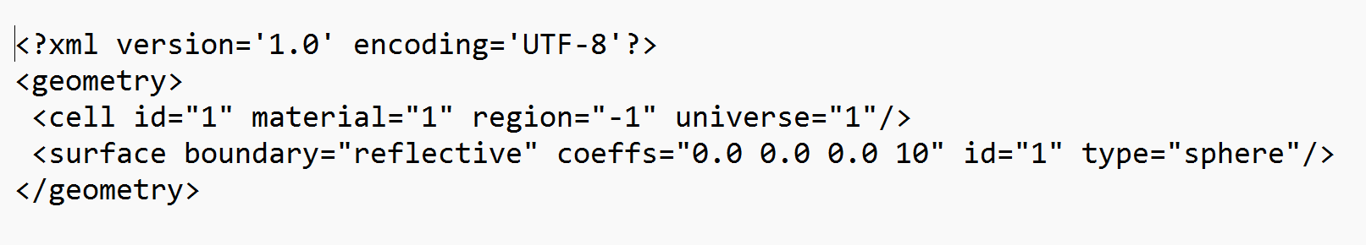
Methods – Translation to OpenMC

Slide 10
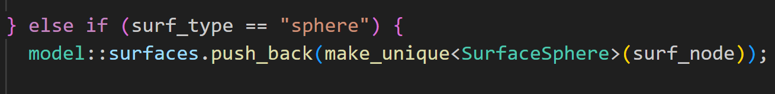
Methods – Future Direction
Leverage existing OpenMC methods for reading surfaces from .xml
Assign surface types to corresponding MOOSE mesh generator operation

Slide 11
References
[1] M. Gill, F. Livens and A. Peakman, "Chapter 9 - Nuclear Fission," in Future Energy, 2014, pp. 181-198.
[2] J. J. Duderstadt and L. J. Hamilton, Nuclear Reactor Analysis, John Wiley & Sons, 1976.
[3] National Nuclear Data Center, "Evaluated Nuclear Data File (ENDF)," [Online]. Available: https://www.nndc.bnl.gov/endf/. [Accessed January 2025].
[4] Idaho National Labratory, "Multiphysics Object-Oriented Simulation Environment," [Online]. Available: https://mooseframework.inl.gov/releases/moose/v1.0.0/. [Accessed January 2025].
[5] Massachusetts Institute of Technology, UChicago Argonne LLC and OpenMC contributors, "The OpenMC Monte Carlo Code," [Online]. Available: https://docs.openmc.org/en/stable/index.html#. [Accessed January 2025].
[6] Idaho National Laboratory, "SphereMeshGenerator Class Reference," [Online]. Available: https://mooseframework.inl.gov/docs/doxygen/moose/classSphereMeshGenerator.html. [Accessed January 2025].

